Slide 1
Crime in Denver
Warren Stokes

Slide 2
Business Problem
Denver Colorado Is a very busy place full of grocery stores, restaurants, and other small businesses. Part of this is due to the massive inflow of people moving to Colorado for business and other factors. Since there is a lot of people moving into a place they have never been before I wanted to create a module that will help them determine the best places to live. The plan is to look at the crime in the area so people can understand the safest places to live based on the crime dataset.

Slide 3
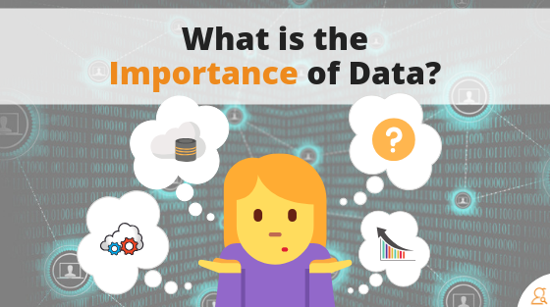

Importance of data
Our state's population grows by about 60,000 to 75,000 people per year!
There are plenty of people that don’t know where is safe to live in Colorado
This data should help some know the best places to live just based on the crime in that area

Slide 4

Acquiring the data/cleaning
The data collected came from the city of Denver’s open data catalog
The data keeps track of things like locations, districts, offense type, dates, etc
The data has 477,213 rows and 19 features in the raw dataset
The cleaned data still has 477,213 rows but now has 11 features instead

Slide 5
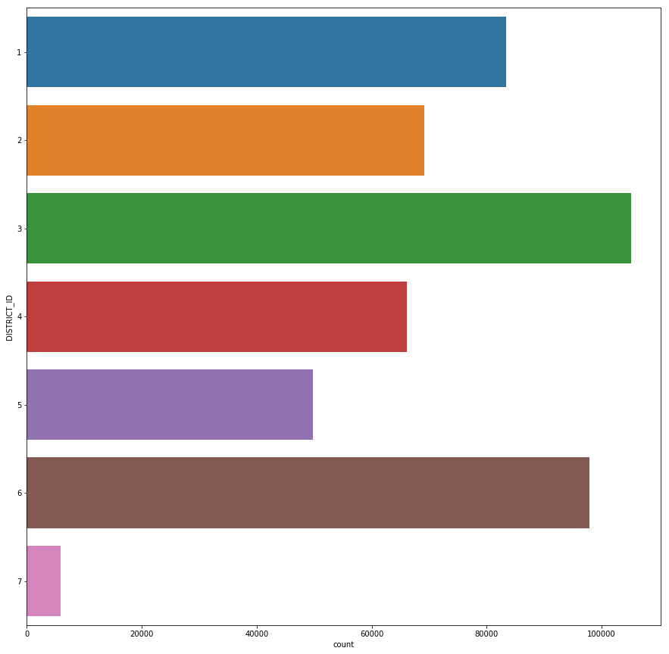
Crimes Separated by District
Count or the x coordinate is the amount of crimes
DISTRICT_ID or the y coordinate is one of the 7 districts
The districts are are made up of various neighborhoods

Slide 6
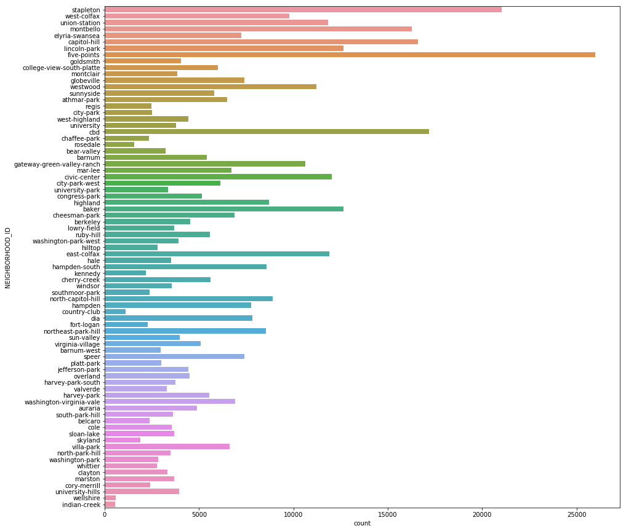
Crimes Separated by Neighborhood
Count or the x coordinate is the amount of crimes
NEIGHBORHOOD_ID or the y coordinate is one of the many neighborhoods in Denver
Based on this Lincoln park has the highest amount of crime

Slide 7
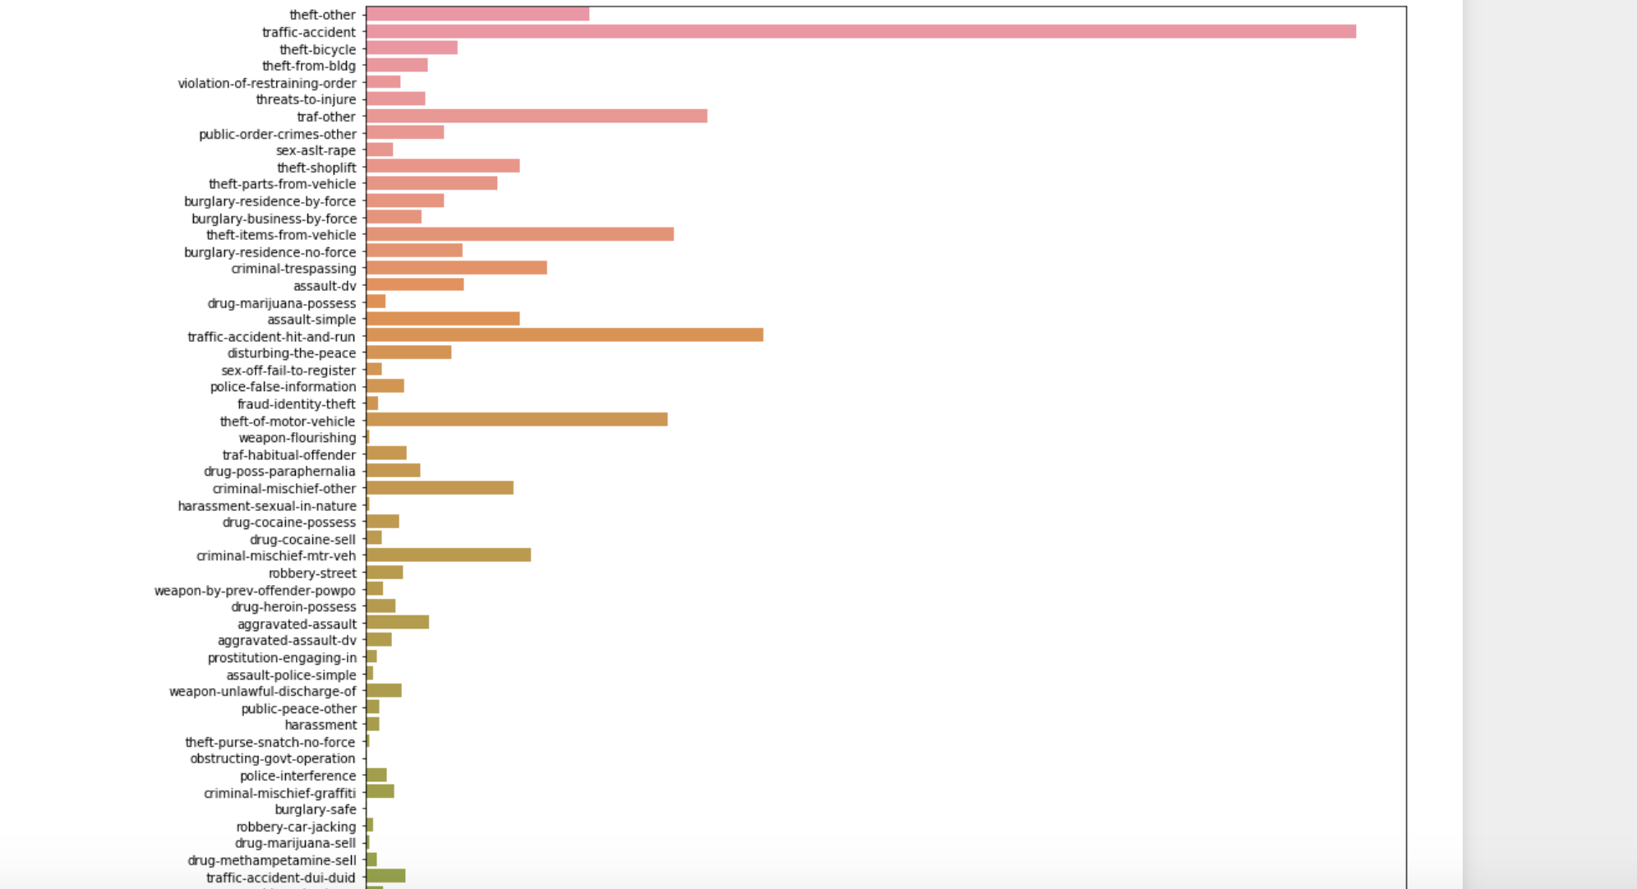
Highest recorded crimes

Slide 8
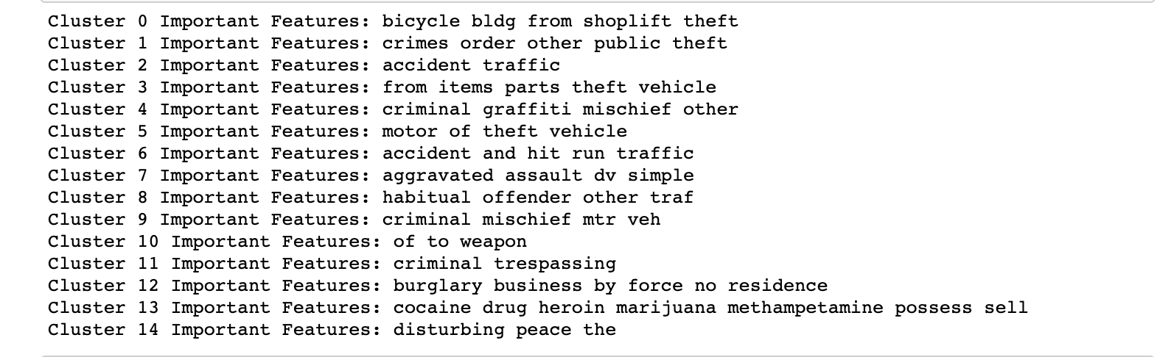
K Means clustering 1
I had used K Means clustering to try to match data that seemed similar
To the right are the 15 different clusters that it came up with
Each will be used to plot points on a map of Denver

Slide 9
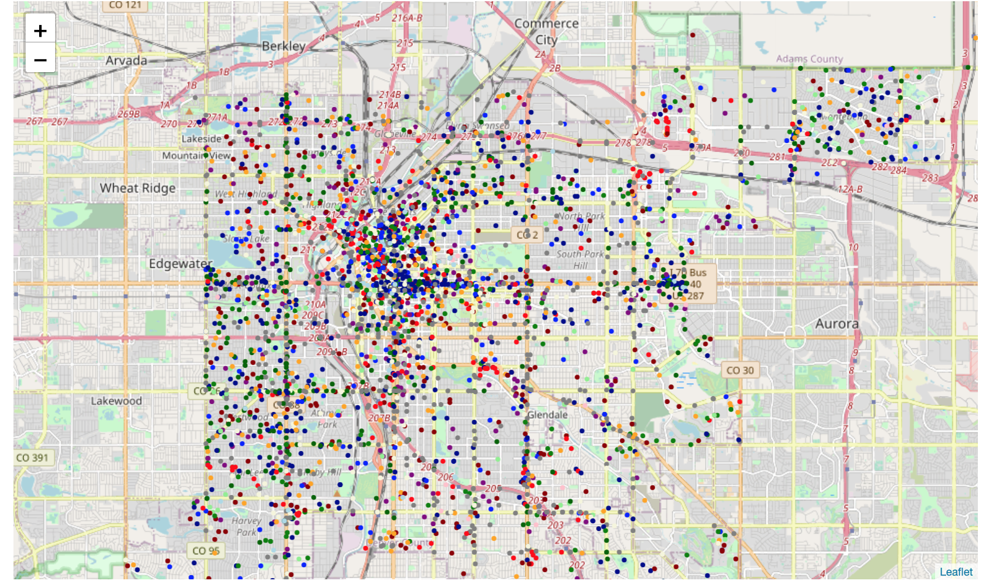
K Means clustering 2

Slide 10
Results/findings
looking at the map that uses K means clustering, crimes per neighborhood bar plot, and crimes per District bar plot There are definitely a lot of good places to live in Denver. Based on the Districts alone any neighborhood that is within the 7th district recording 5,909 recorded crimes. The crime data does include things like traffic accidents. Traffic accidents actually is the most recorded crime in Denver which makes sense. With these finding I felt that it was better to use machine learning to try and merge similar crimes into a cluster to then be plotted on the map. I've split it into 15 different clusters and it came out pretty good. Since there are so many points that I could plot on the map I had to reduce the amount that actually showed up on the map so It was somewhat coherent and understandable. While I do feel this has a lot of potential to be useful there is always room to improve to better the machine learning model.

Slide 11

conclusion
In terms of finding the best place to live you'd probably want to consider more factors like housing costs, stores in the area, etc. Based off of the findings there are plenty of neighborhoods that have fairly low rates of crime. Looking at the folium map above it appears that the more you leave the heart of Denver the lower the crimes occur, this could change with all of the points on the map but I'm pretty sure it would stay consistant.

